Slide 1
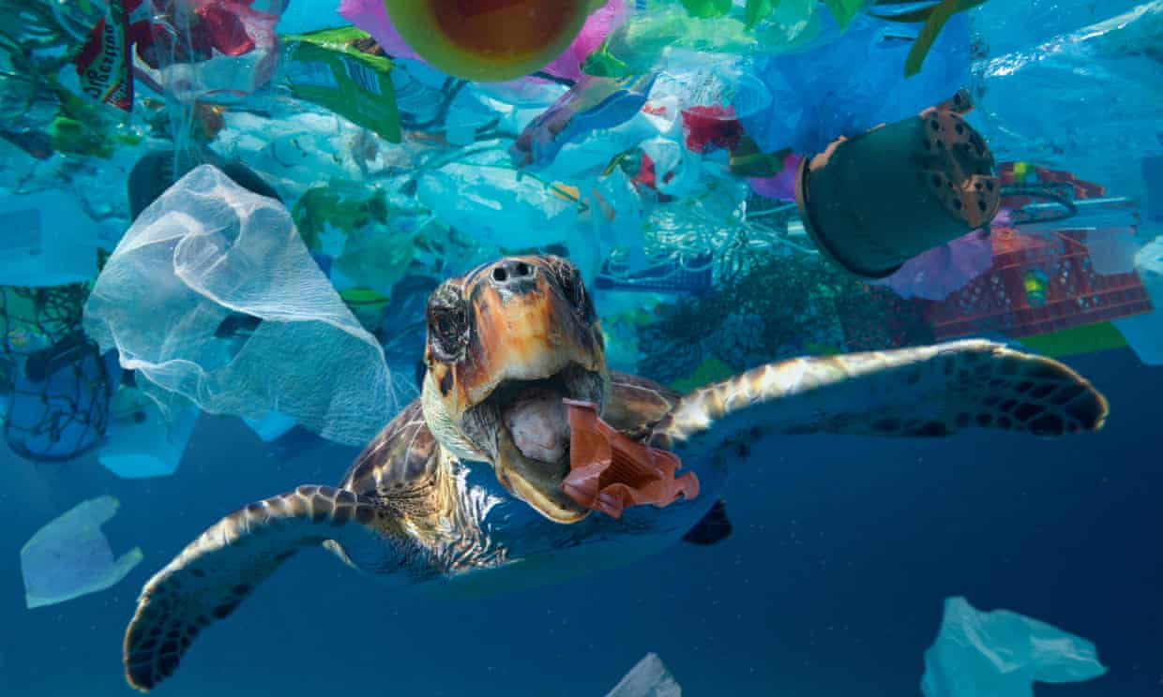
Plastic PullOutCean
A trip surrounded by plastic
&
21 Days to save the planet

Slide 2
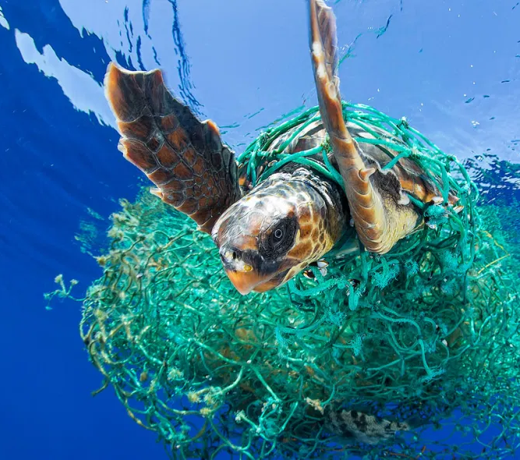
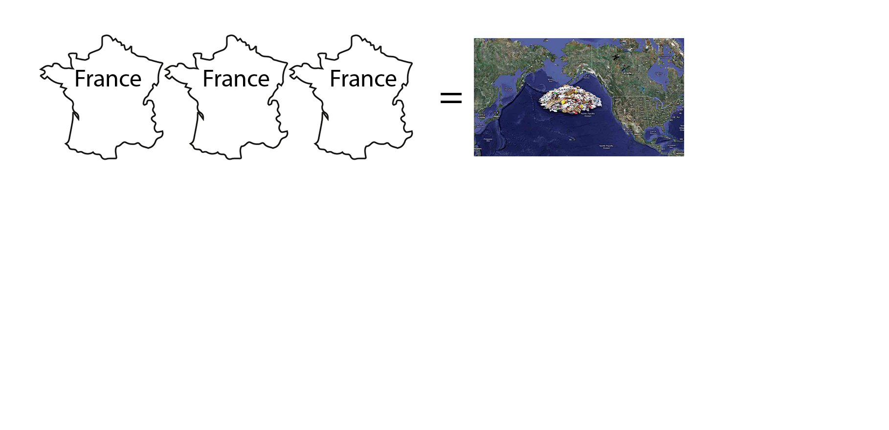
The context
Day by day, plastic is flowing into our natural environment. The end point of this trip is often the Ocean.
The amount of plastic into the ocean increases by a quantity equivalent to 33800 plastic bottles every minute, now it is like 3 times France’s surface.
Every year, ocean pollution kills 100000 animals surrounded by our plastic garbage.
Ocean doesn’t belong to plastic. We are all part of the problem, but now it is time to be involved in the solution!

Slide 3
The idea: where we started
Plastic PullOutCean is a project to allow people to really feel how is to be suddenly into an ocean full of plastic.
In order to rise the awareness around this issue, through a claustrophobic experience surrounded by plastic, without the chance to escape, unless using an ecological behaviour.
The idea is to create an interactive installation, where virtual reality and good action in real world are connected to find a way to clean both real and virtual ocean.

Slide 4
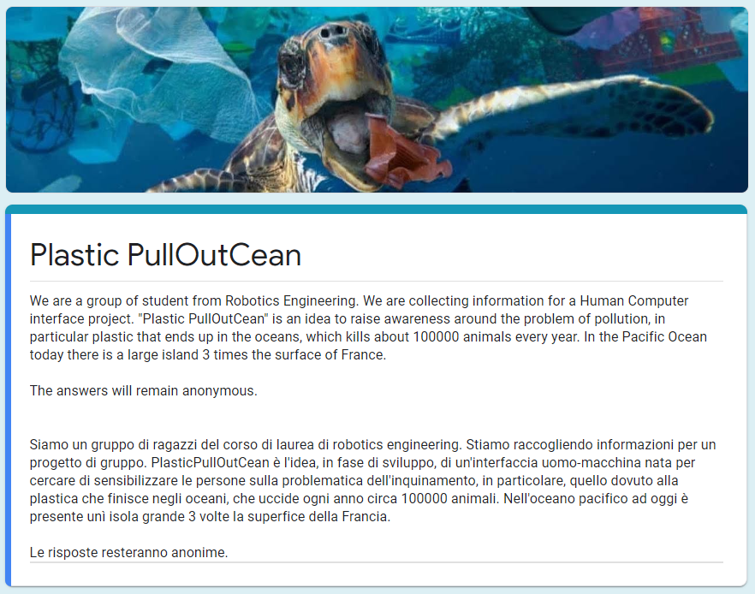
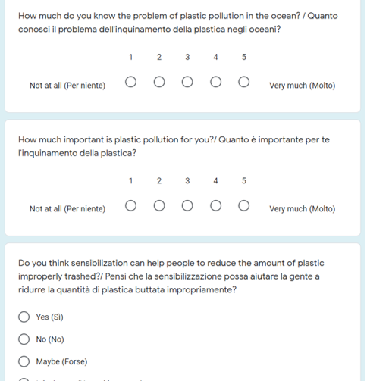

Methods of investigations
Questonnaire
https://forms.gle/6jArf4z2ZEpf8jxP9

Slide 5
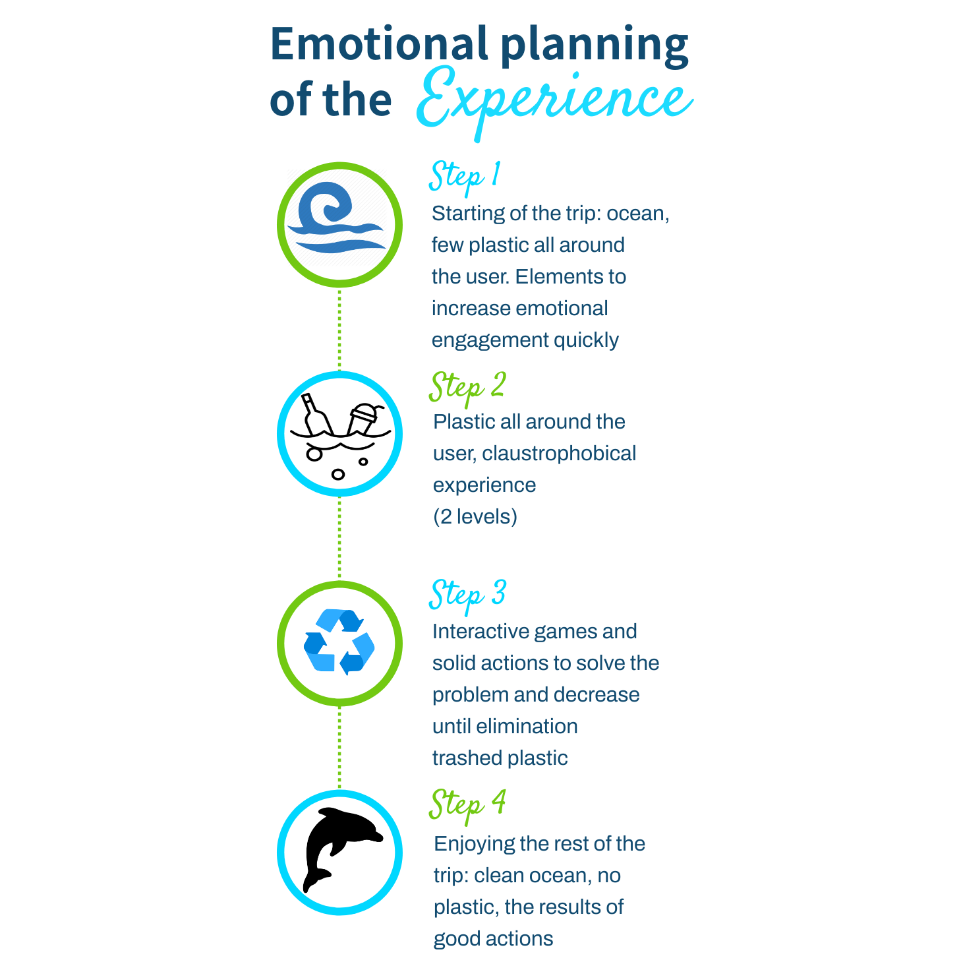
The idea: how we proceeded
An installation inspired by projects of Ars Electonica and Studio Azzurro (3rd iteration in the folder)
Emotional interface to have a claustrophobical experience that involves whole body
Purpose: Increase awareness around plastic pollution, education, change no ecological behaviours

Slide 6
The idea: just a sketch of where we arrived
Emotional experience in augmented reality
Social interface: 21 days of challenge
Discovering how good action can change the situation

Slide 7
The idea: where we arrived
Emotional experience: an immersive exhibition in a cultural place, where a group of 10 people has a claustrophobic trip into the plastic ocean
Social interface: An app, linked to the exhibition, where we propose a challenge: 21 days of collecting plastic. Enjoying this time bonding with other users during the collection
Discovering how good action can change the situation, circular narrative: relive part of the exhibition on the phone with the improvements in the ocean made by the user

Slide 8
Our immersive room
A room where videos in 3D are projected in high resolution on the walls, the floor and the ceiling (videomapping).
Immersive audio by speakers all around the users to convey emotions. The presence of other people allows the emotional contagion
Air jets all around the room close to the users, in order to perform the tactile side and the smell of what they are watching

Slide 9
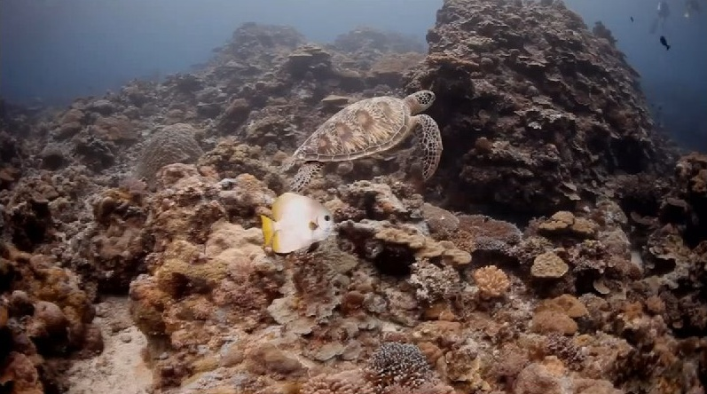
The exhibition (N.C.-14)
A 3D high resolution video. For each person in the room the interface increases the number of plastic all around.
An important aspect to feel the sensation of claustrophobia is the sonification.
There is two merged different moments:
Almost no plastic around the public, a relaxing video and music plays in the room
An escalation of plastic all around, “The Mole” by Hans Zimmer plays increasing the uncomfortable feeling of anxiety thanks the sound illusion “Shepard Scale”.
At the end, the group of users is invited to download the app to take part in our challenge
WARNING! The video in the demo contains material that may be harmful or disturbing to some audience

Slide 10
Target of the exhibition:
Environmental organization (WWF, Greenpeace ecc… ecc…).
National governments and international organisations.
Aquarium.
Component within the exhibitions.

Slide 11
Why have the exhibition and the app together?
The emotional experience can:
reach also those people who are not aware around the problem yet
Encourage action thanks the creation of a team
The app can :
create a social experience to have fun and bonds during collection.
be downloaded also by external aware people
The app helps to have a real and practical approach to take action,before plastics reach the ocean
Based on Dr. Maxwell Maltz studies, 21 days are the minimum necessary to have a new habit
Starting from a passive state, the user complete a full arch of awereness to become active in the solution. We use the gamification technique to involve the user

Slide 12
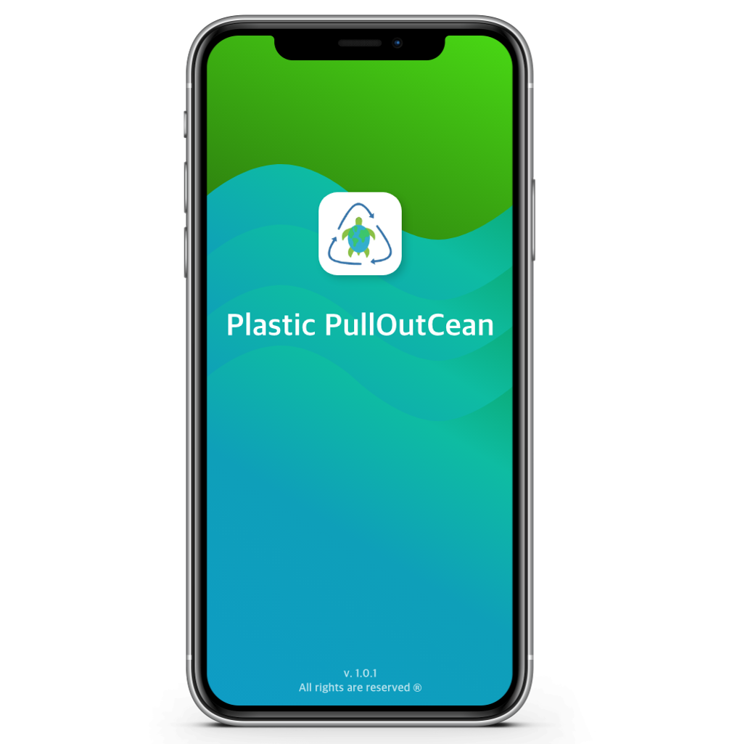
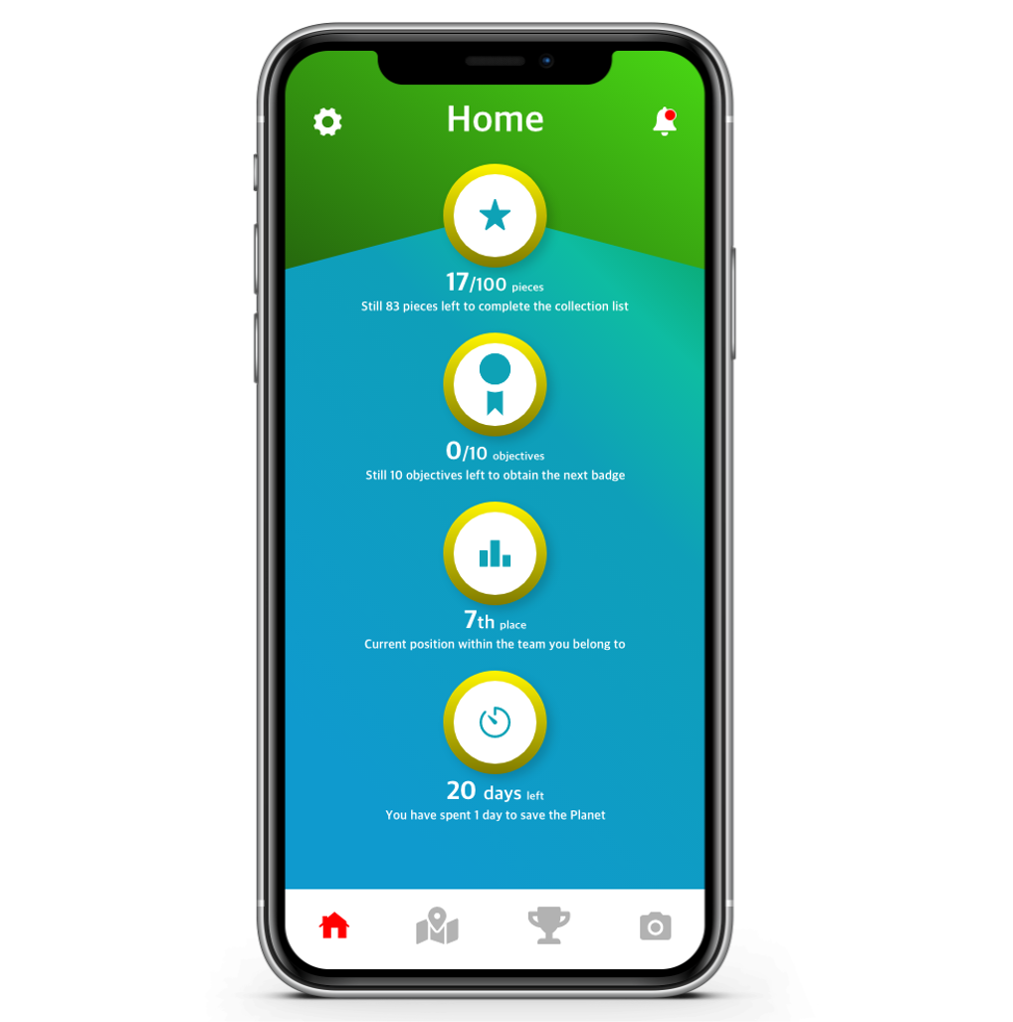
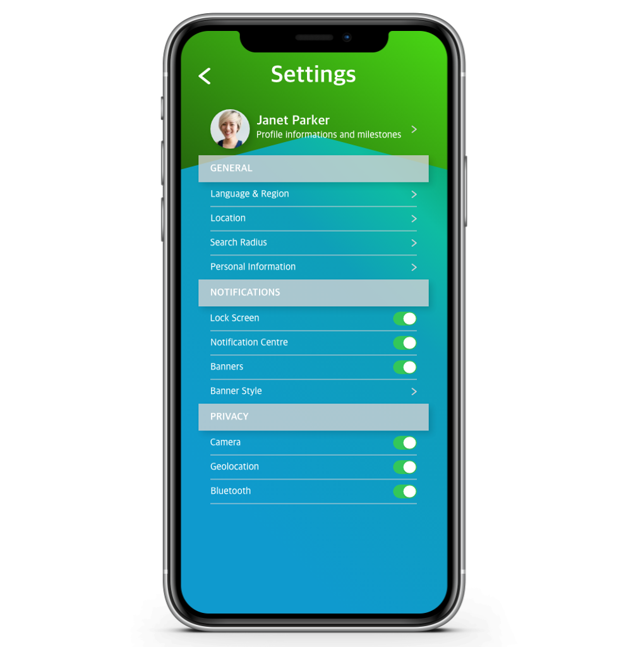
Plastic PullOutCean - Home & Settings
The splash screen is characterized by the logo, and its colours will be taken on subsequent screens.
The chosen colours are: blue and green to recall the ocean and the ecology.
Each participant will be able to keep track of their goals through the home screen.

Slide 13
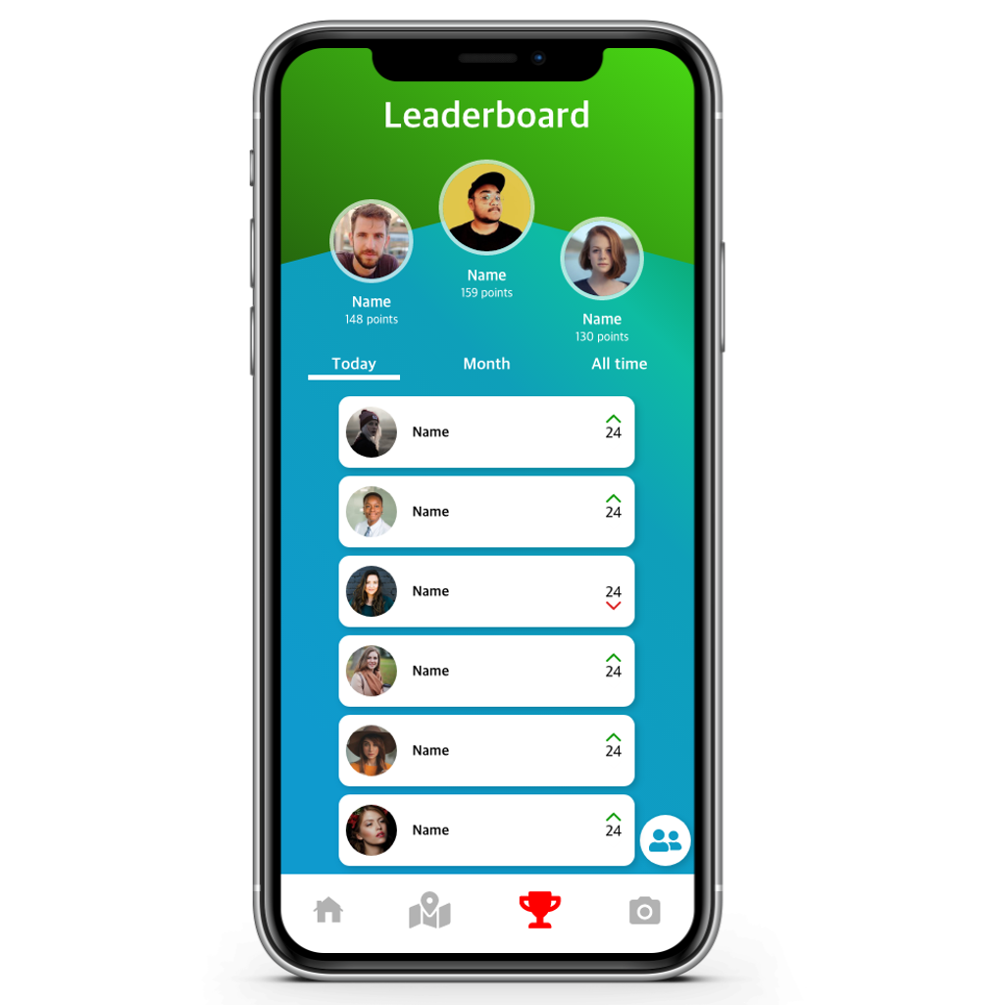
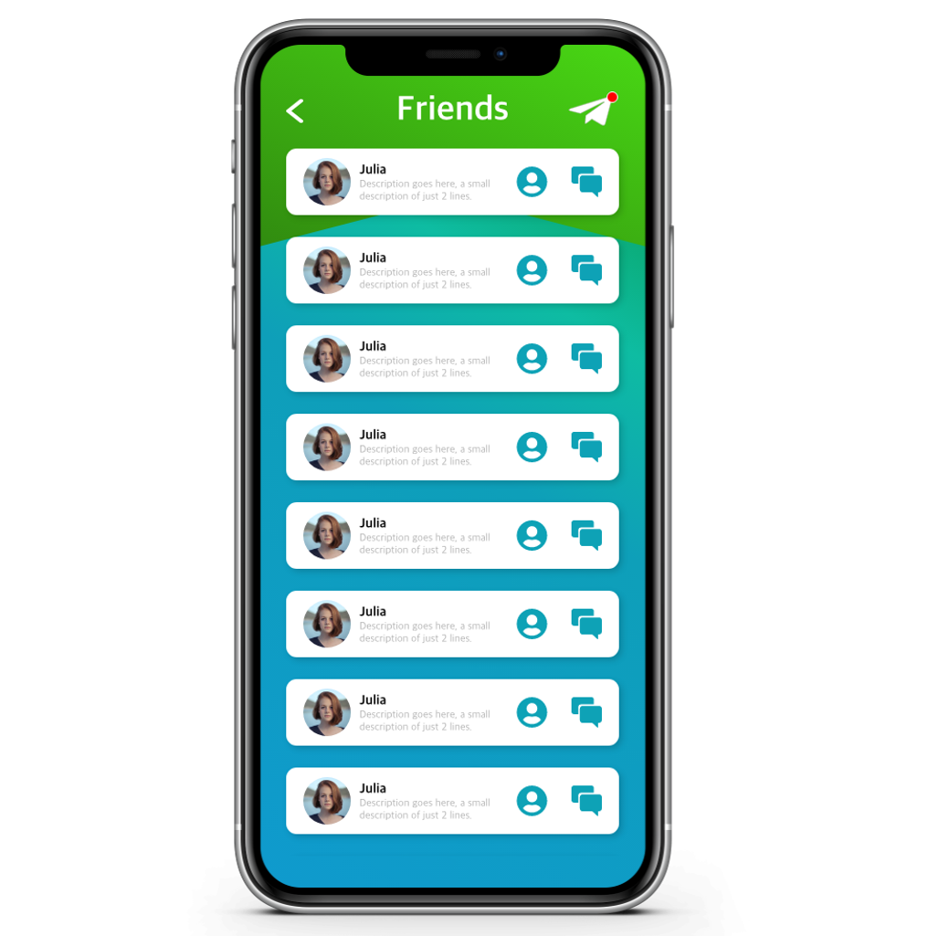
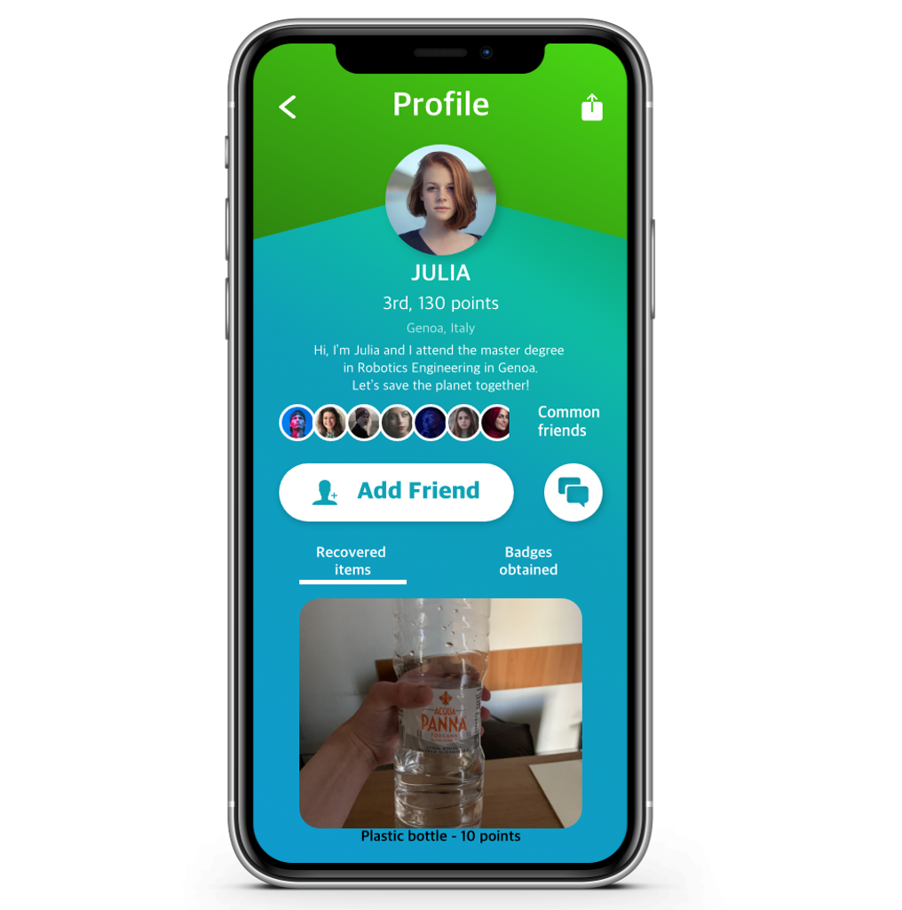
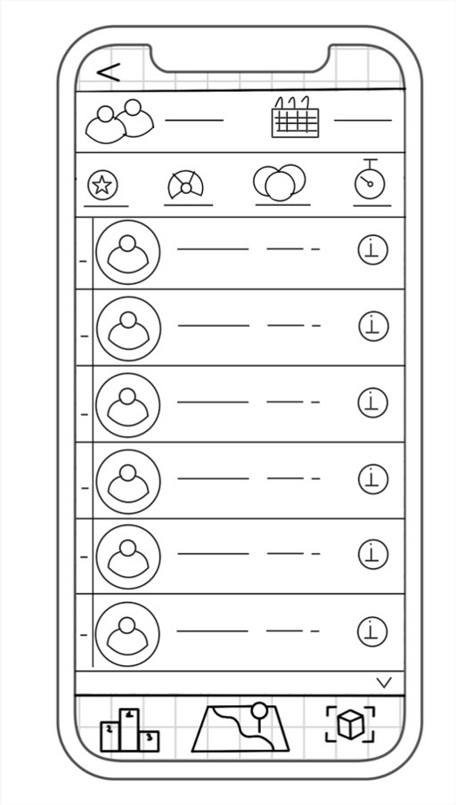
Plastic PullOutCean – Leaderborard & Profile
People that have the experience together become a team.
Each team competes with others in collecting plastic during 21 days.
The app shows a general rank: this increases the cooperation inside a team.
Each person can become the leader of his/her team, collecting more plastic than other members
We focused on: learnability, memorability and simplicity

Slide 14
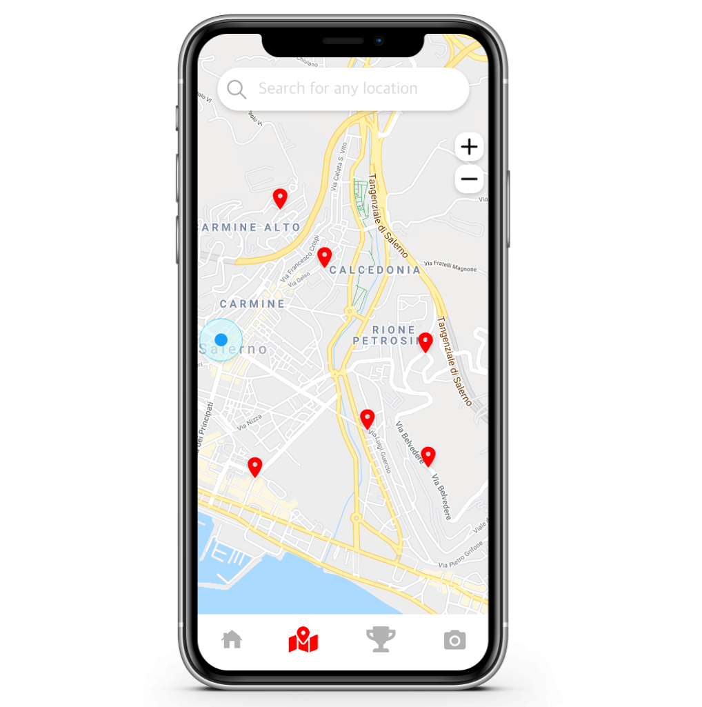
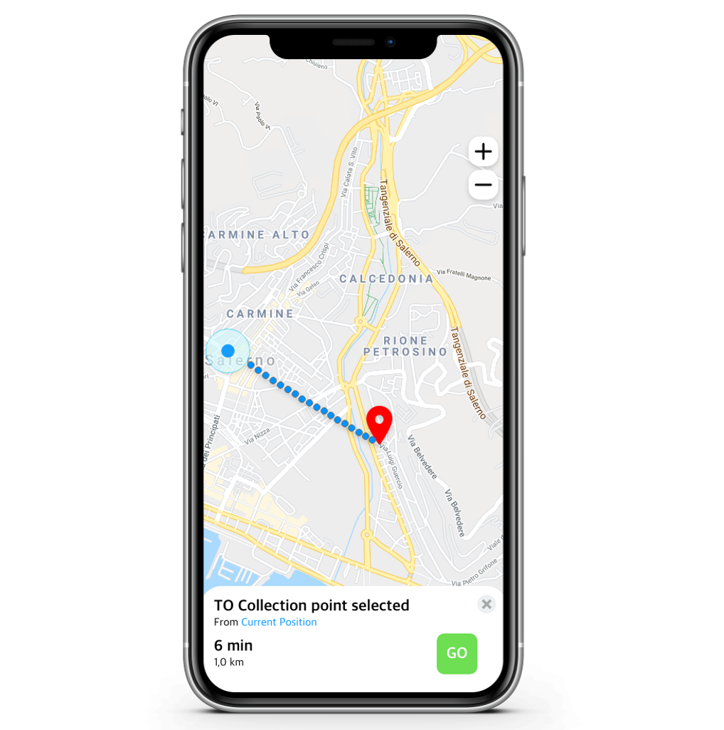
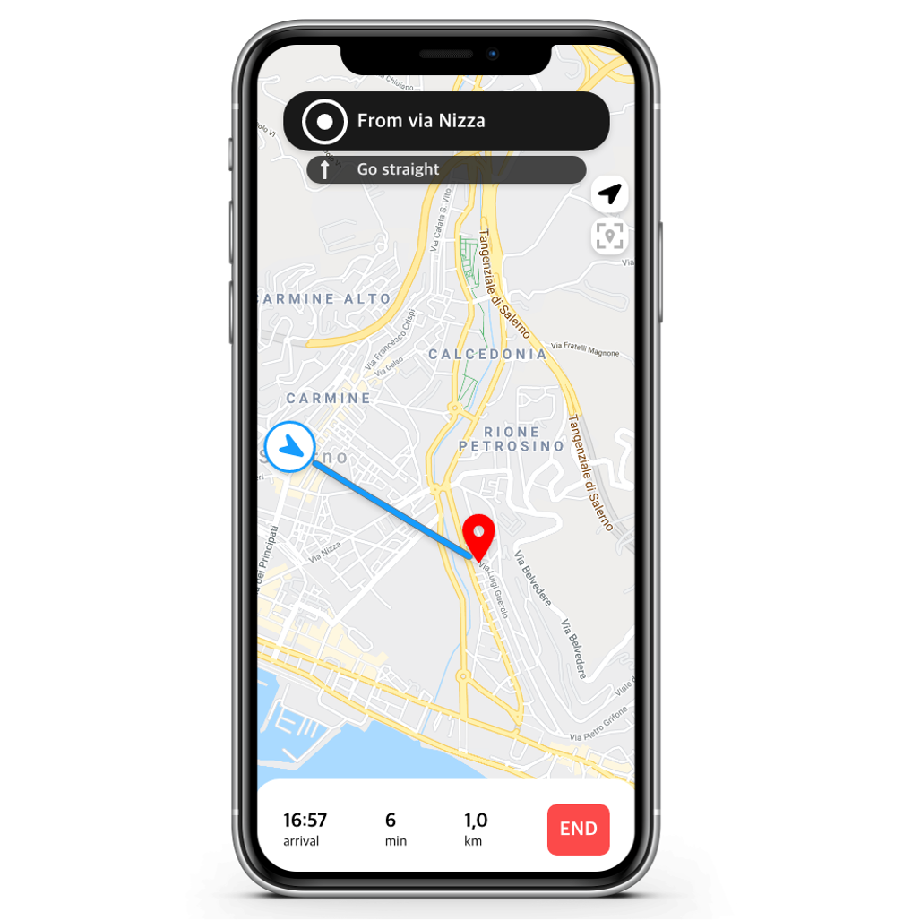
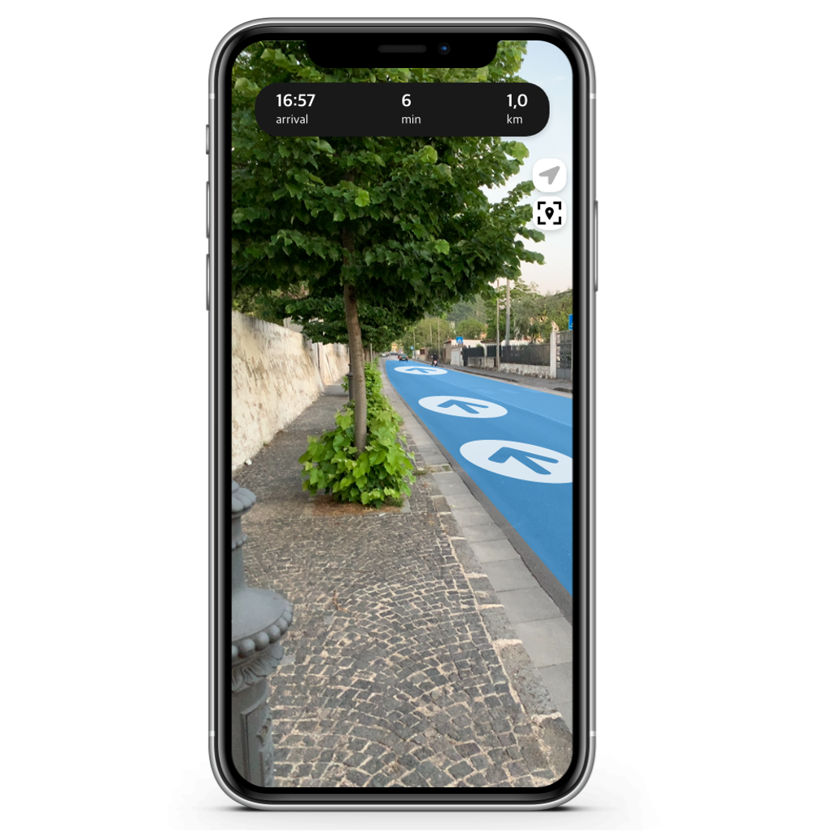
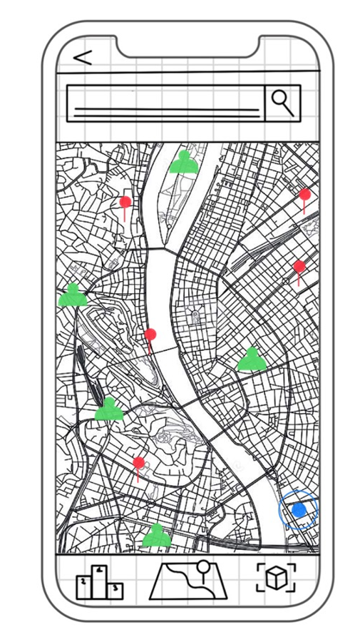
PlasticPullOutCean - Map
It was necessary to develop a map with adjoining navigation, in order to allow each user to reach a collection point.
Once the navigation has started, the user can choose whether to use a standard or live mode, both supported by step-by-step directions.

Slide 15
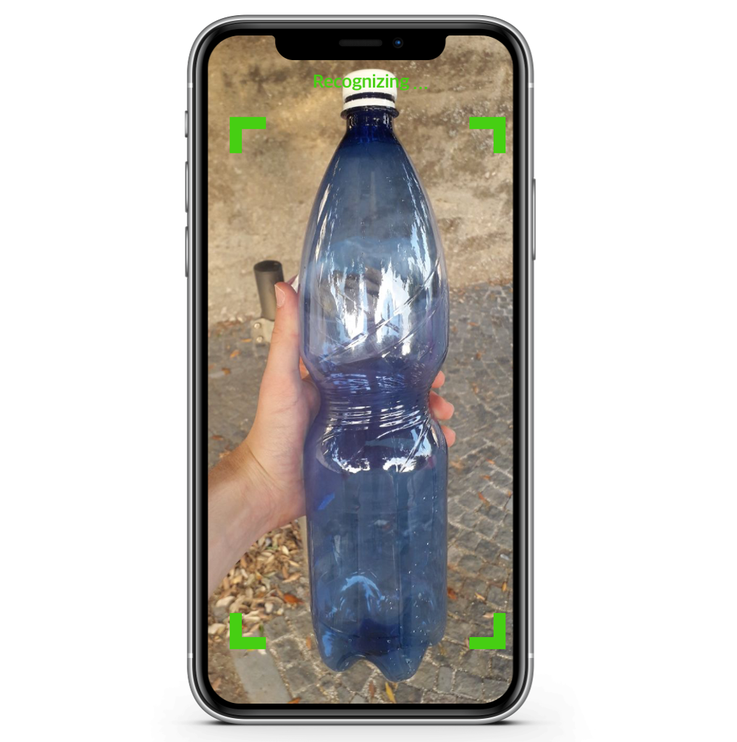
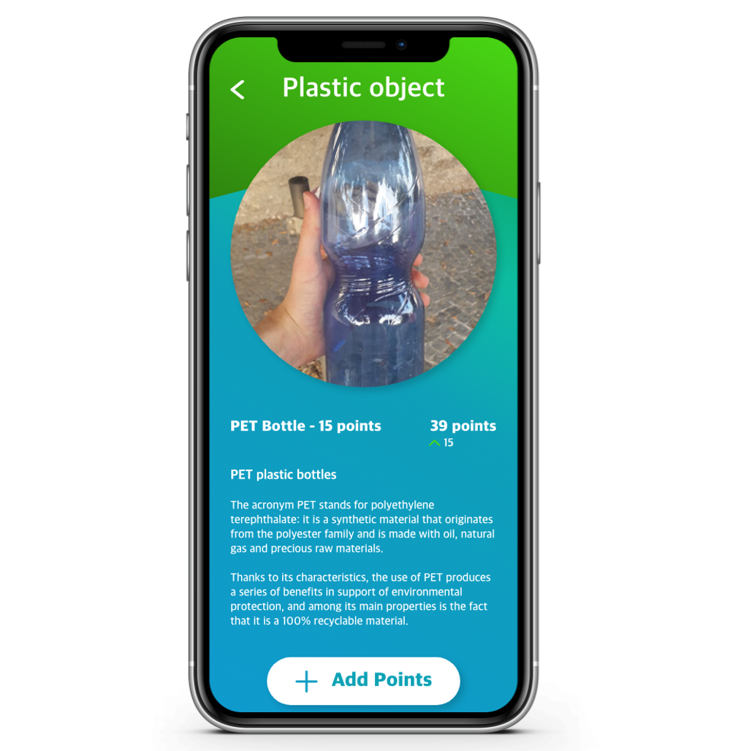
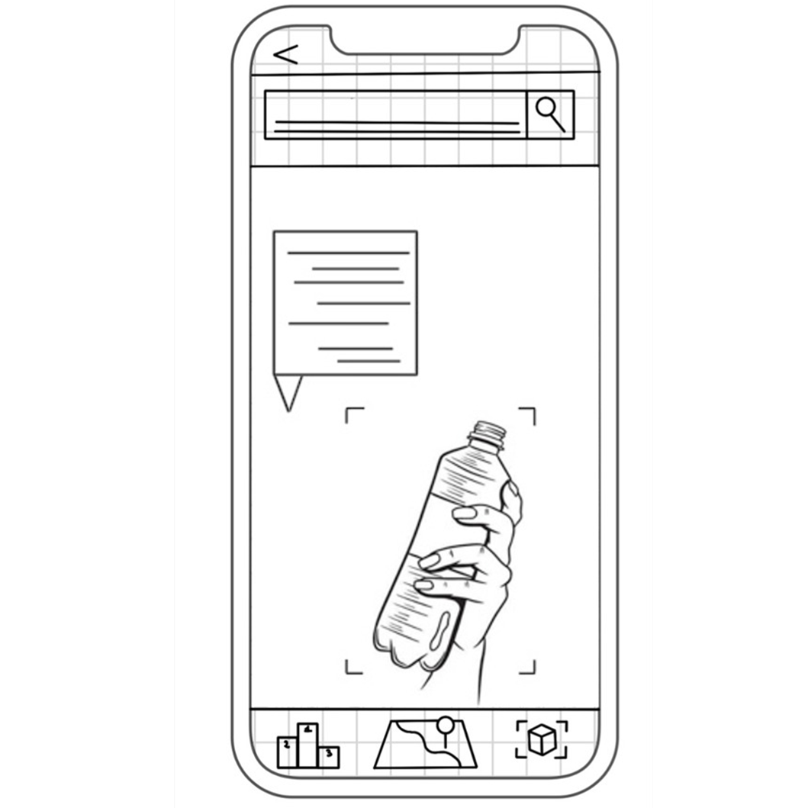
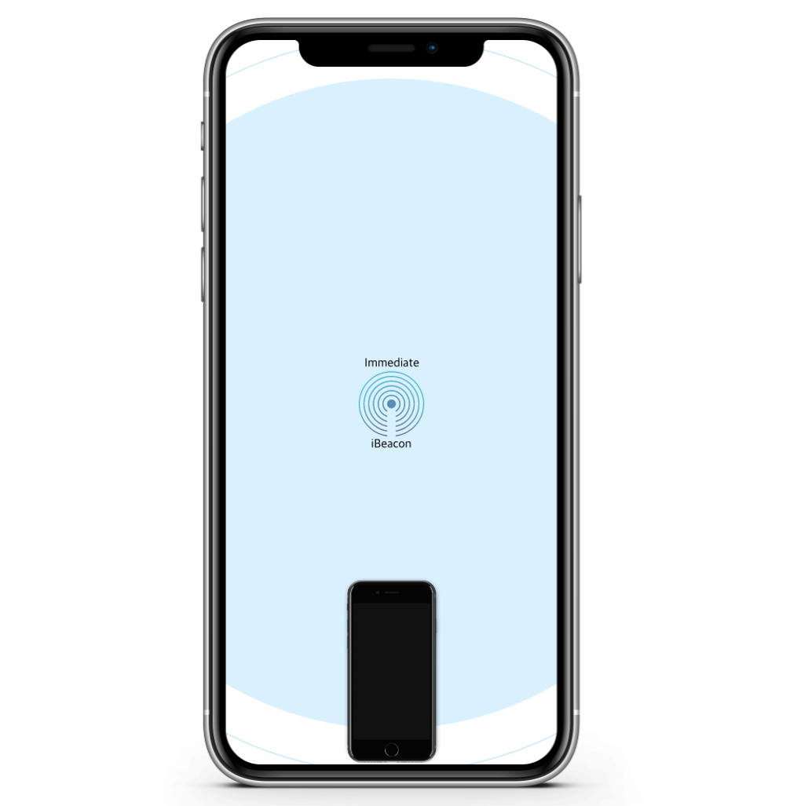
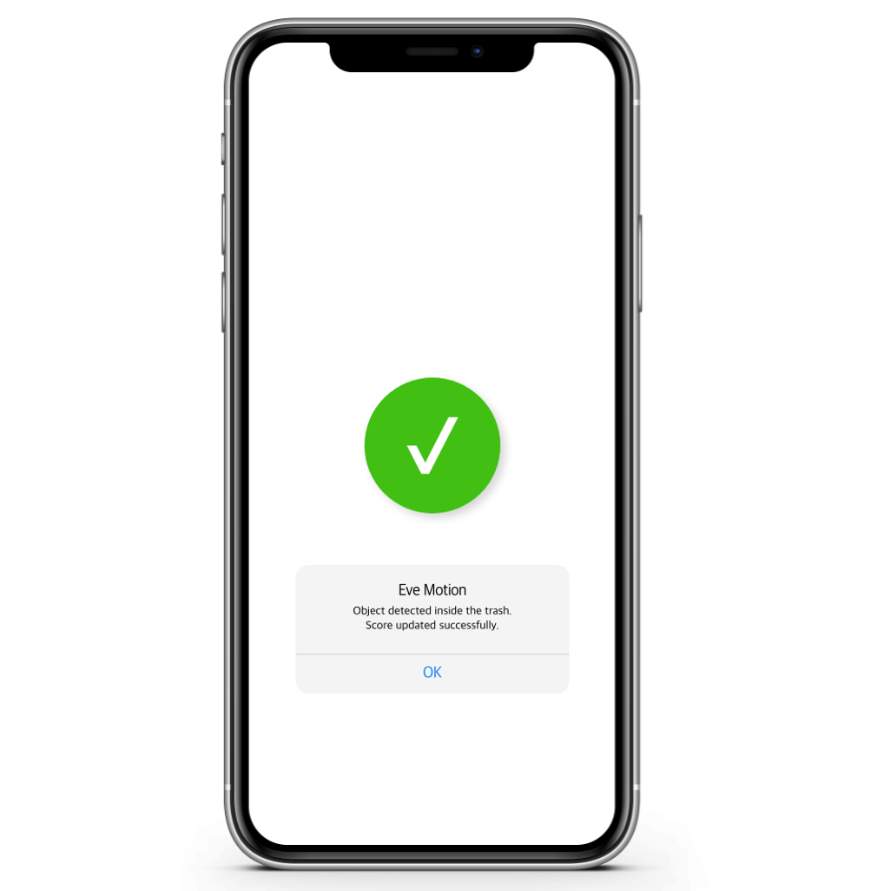
PlasticPullOutCean – Object recognition
Using a specially developed recognition algorithm, it is possible to recognize a plastic object using the camera of its own device.
According to the framed object, a score will be assigned, and information will be given regarding such material. Here we use the chucking and rehearsal technique in order to help the user to memorize this information.
The assignment of points is subject to the immediate proximity of the user from the basket. This verification is facilitated using a beacon, positioned inside the basket itself.
Once the refusal is thrown into the trash, the user's score will be updated. This verification is possible by a motion sensor, which is also positioned inside the basket.

Slide 16
Purpose
Educational
Increase awareness
Encourage a virtuous behavior

Slide 17
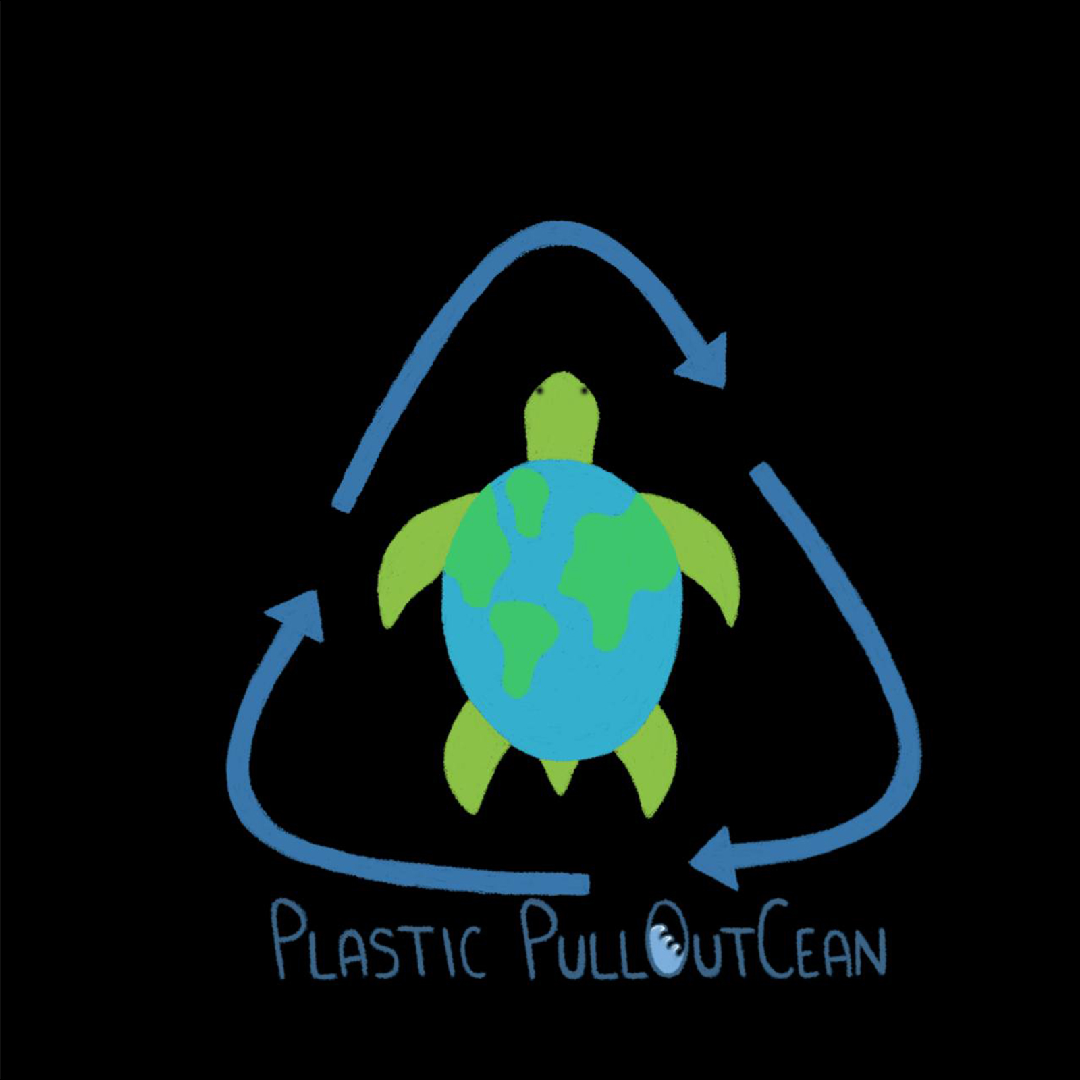
Our team
Ilenia D’Angelo, Mechanical engineer
Ileniadangelo94@gmail.com
Giovanni Di Marco, Electronics engineer
giovannidimarco06@gmail.com
Riccardo Zuppetti, Computer engineer
Riccardo.zuppetti@icloud.com

Slide 18
Thanks for the attention, enjoy the demo!

